Slide 1

Tuberculosis Prevailence In Nigeria
Mini Data Analysis on Historical Data
Presenter：Fehintolu Samuel
Date：2025.4

Slide 2

01
Tuberculosis Overview
contents
02
Data Sourcing and Analysis
03
Data Alanylsis

Slide 3

PART 01
Tuberculosis Overview

Slide 4



Tuberculosis (TB) Overview
Tuberculosis Brief (TB)
TB is a chronic infectious disease caused by Mycobacterium tuberculosis, mainly affecting the lungs (pulmonary TB).
It can also affect other organs (extrapulmonary TB), with symptoms including persistent cough, fever, weight loss, and night sweats.
TB spreads through airborne droplets when an infected person coughs, sneezes, or speaks.
Infection risk increases in overcrowded, poorly ventilated environments; latent TB can become active if immunity weakens.
High rates of under-diagnosis, under-reporting, and TB-HIV co-infection challenge effective control.

Slide 5
PART 02
Data Sourcing and Analysis

Slide 6
Sourcing and Analysis
Source
A comprehensive dataset was sourced from kaggle. I was a collection of health , and health impact datasets peculiar to Nigeria, gotten from various world health organization databases such as UNICEF, DHO, etc.
Data Cleaning and Storage
Python was used for data cleaning, MysQL was used for storing the cleaned dataset, and Power BI was used for Visualization
Insights , Inferences, and Recommendation
Based on findings, insights were generated and recommenddations were made.

Slide 7
PART 03
Data Analysis

Slide 8
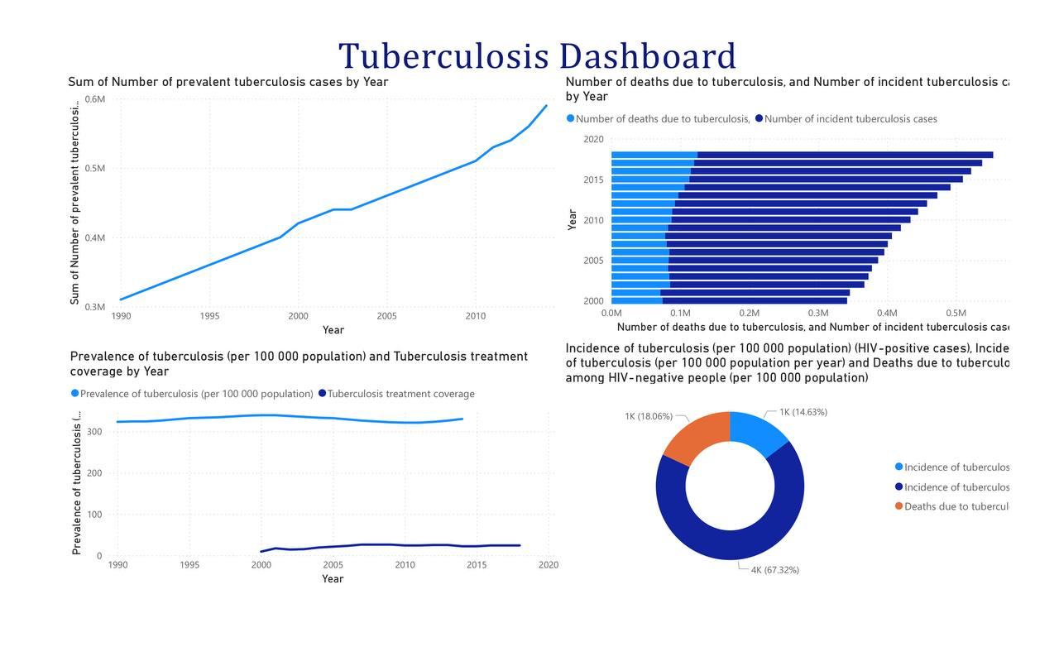

Slide 9

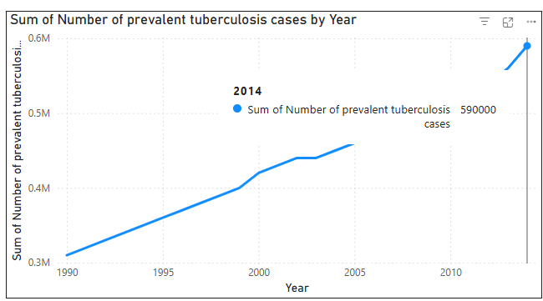
TB Prevalence per 100,000 of population
The number of prevalent TB cases rose steadily from 0.3 million to 0.6 million between 1990 and 2010, signaling sustained transmission despite ongoing control efforts.
Inference:
• Slow progress in interrupting TB transmission.
• Suggests gaps in early diagnosis and access to treatment.

Slide 10
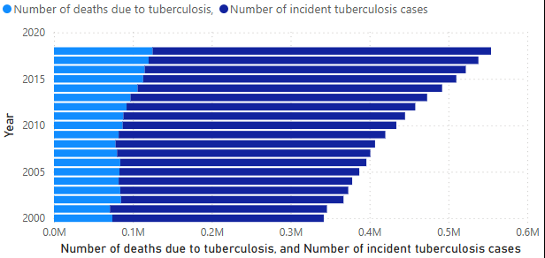
Number of TB Cases and Deaths
TB-related deaths show a gradual increase from 2000 to 2020, while incidence rates remain high. This convergence implies less success in treatment, and persistent challenges in prevention and early detection.
Inference:
• Population-level burden of TB is increasing.
• Indicates less effectiveness of Nigeria health investments.

Slide 11
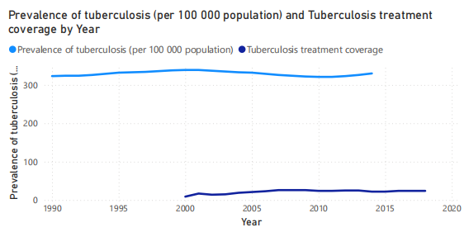
TB Treatment Coverage (1990–2020)
Coverage has been consistently steadyincreased, particularly post-2005. This increase is closely linked to enhanced funding, policy changes, and global partnerships including WHO’s End TB strategy.
Inference:
• The steady increase is owed to different factors such as global health patnerships and policy changes.

Slide 12
Policy Recommendations for Nigeria Health Sector & Global Partners
Treatment Access
Early Detection
Expand TB treatment access with community-level outreach
Prioritize early detection and vaccination
Funding
Research
Data Systems
Increase funding for national TB programs.
Support global research on drug-resistant TB strains.
Invest in real-time data systems and digital health tools.

Slide 13
THANK YOU！

